Slide 1
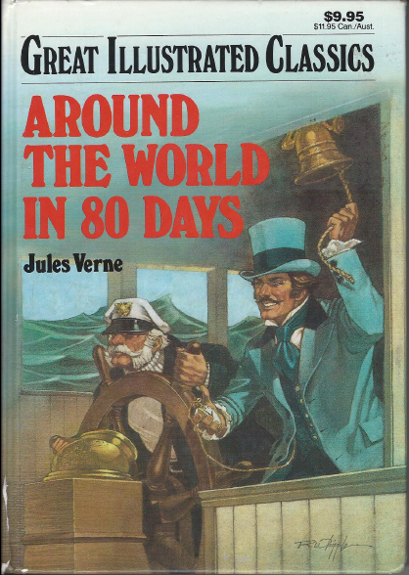
Around the World in 80 Days by Joules Verne
Mysterious Bookworm Society
March 22, 2012

Slide 2


Oh!, the places we will go….
Phileas Fogg planned to go to the following places
From | Travel Time | To
London, England | 7 | Suez, Egypt
Suez, Egypt | 13 | Bombay, India
Bombay, India | 3 | Calcutta, India
Calcutta, India | 13 | Hong Kong
Hong Kong | 6 | Yokohama, Japan
Yokohama, Japan | 22 | San Francisco, USA
San Francisco, USA | 7 | New York, USA
New York, USA | 9 | London, England
 | 80!
That is a total of 80 Days!

Slide 3
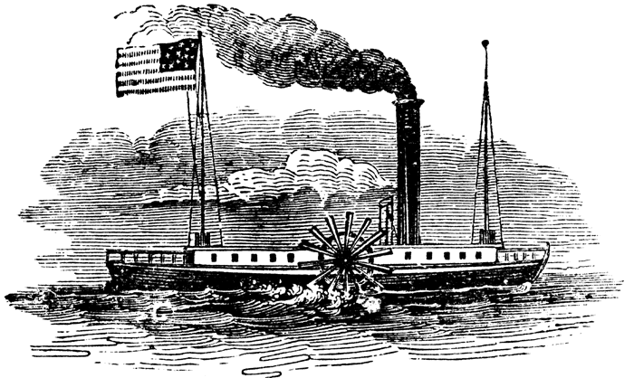
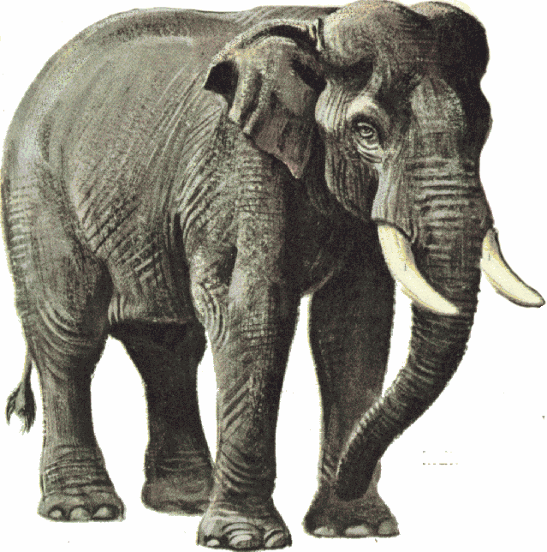
What kinds of Transportation did Phileas use in his trip?
The “Sledge”

Slide 4
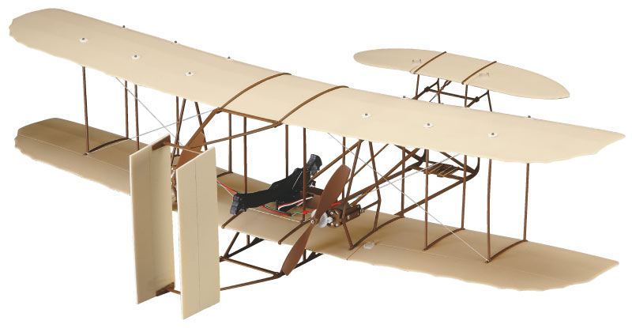
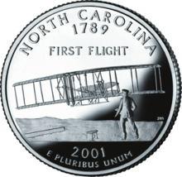
Around the World in 80 Days!
Why Didn’t Phileas Just Take a Plane?!!!!
Orville and Wilbur Wright developed the first powered Aircraft
Their first flight was December 17, 1903
It took place in Kitty Hawk , North Carolina
North Carolina’s uses the slogan “First in Flight” on its license plates
Our Book was set in 1872, Planes did not exist yet!!

Slide 5
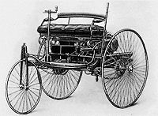
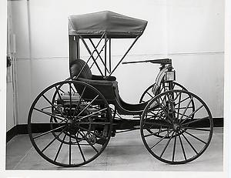
Around the World in 80 Days!
Why Didn’t Phileas Just Take a Car?!!!
Karl Benz created the 3 Wheel MotorWagen in 1883
It is widely recognized as the first automobile
Karl Benz as in “Mercedes-Benz”
Frank Duryea created the 4 Wheel car in 1893
Cars did not exist yet either!!

Slide 6

Did you Read the Book?
Are you a Certified Super Genius??
Then let’s do a Crossword puzzle!
You Better Bring it!!

Slide 7
Around the World in 80 Days!

Slide 8
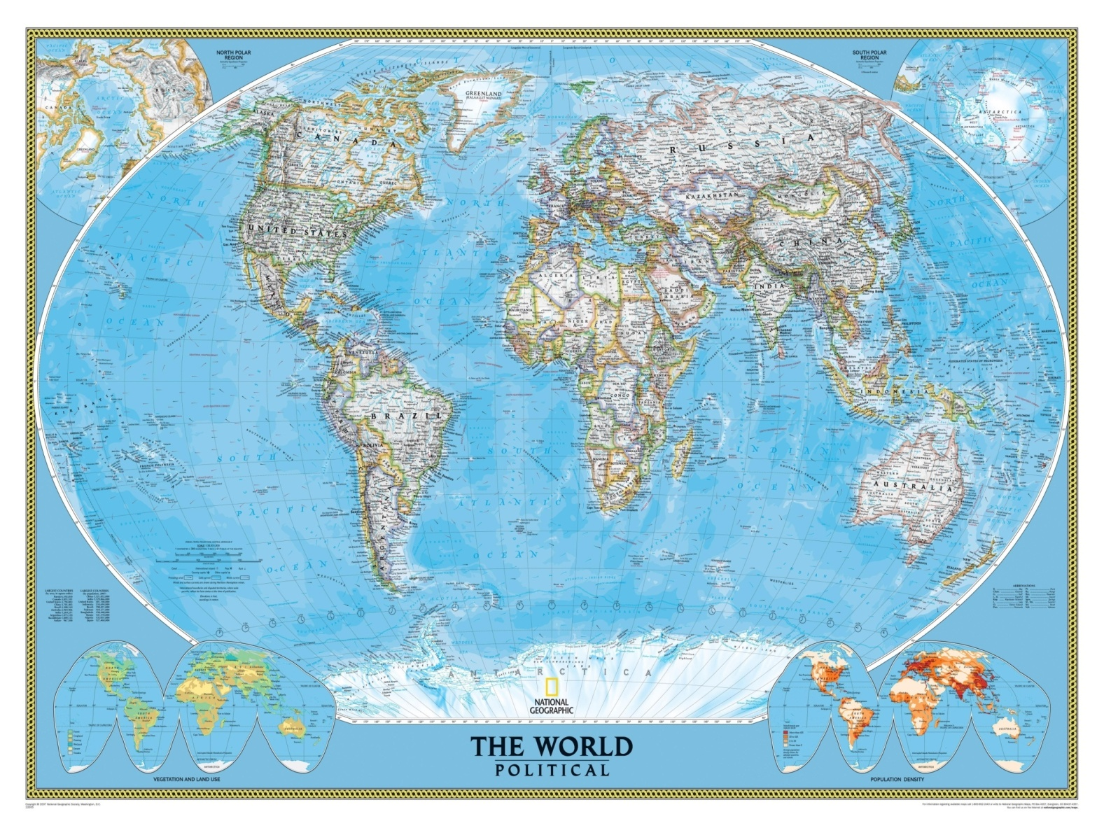
Let’s retrace the trip made by Phileas Fogg on the Map on the Wall.
☺ Please only use the Dry Erase markers ☺

Slide 9
Crossword Answers

